Slide 1

Advanced Thermal Rocket specific Impulse calculation guide
Dakota Santana
Monkey_Commando#2896

Slide 2
Contents
This is intended to serve as a basic guide to using freeware available code for calculating the performance of thermal rockets.
The focus is on nuclear or electro thermal rockets.
Solar-thermal maybe similar, but I have not investigated this much.
A section is devoted to accounting for endothermic decomposition at high temperature and/or low temperatures in such engines.
An approximation methodology is provided to account for the changing chemical composition in the nozzle
Usually this requires CFD codes. NASA’s Two-Dimensional Kinetics (TDK) code is specialized for this.
These are either restrictive (as in TDK) or require specialized knowledge to properly run (general purpose CFD).

Slide 3
Contents
RPA vs CEA
Performing RPA run
Performing CEA run
Accounting for chamber decomposition
Nozzle Kinetics
Frozen vs Equilibrium flow
Sudden-Freeze Model
Getting the Freezing Plane
Implementing the model

Slide 4
RPA vs CEA
RPA (Rocket Propulsion Analysis) | CEA (Chemical Equilibrium with Application)
Made explicitly for rockets using CEA as a base | Wide variety of application for Rockets, Detonation, Shock Tubes, and Chemical Equilibrium
Many features behind paywalls | No paywall
Capable of performing initial investigation of rocket systems including nozzle performance, cycle analysis, cooling requirements, thrust and weight estimates (some features behind paywall) | Ideal nozzle performance only
Thermodynamic property generator for mixture behind paywall | Can calculate thermodynamic properties in a form easily importable to spreadsheet
Expandable and customizable chemical species property database | Limited chemical species database (should not be an issue unless you are going down Nuclear Gas-Core rabbit hole or similar concepts)
Download Here: http://www.rocket-propulsion.com/RPA/download.htm | Web Portal: https://cearun.grc.nasa.gov/

Slide 5
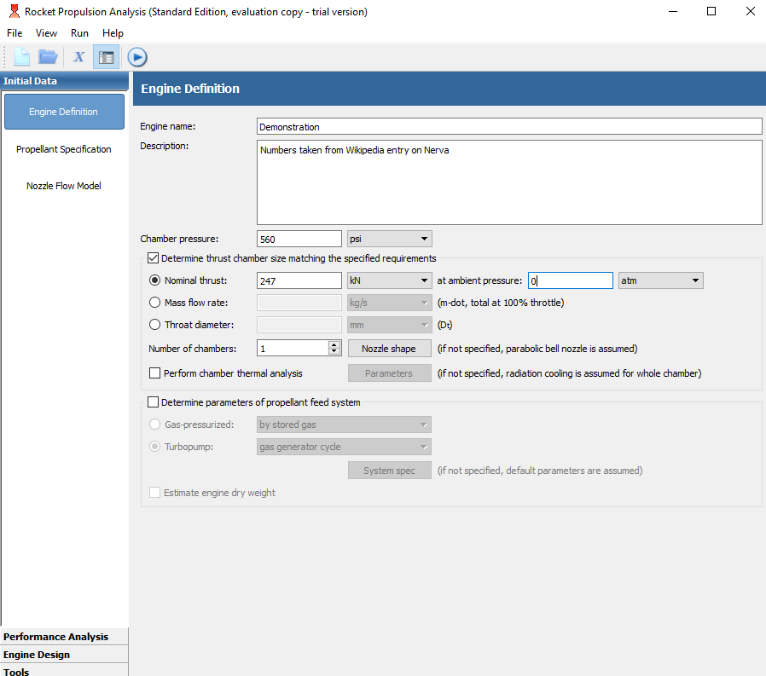
RPA
Required
Required if you want to size the engine for thrust

Slide 6
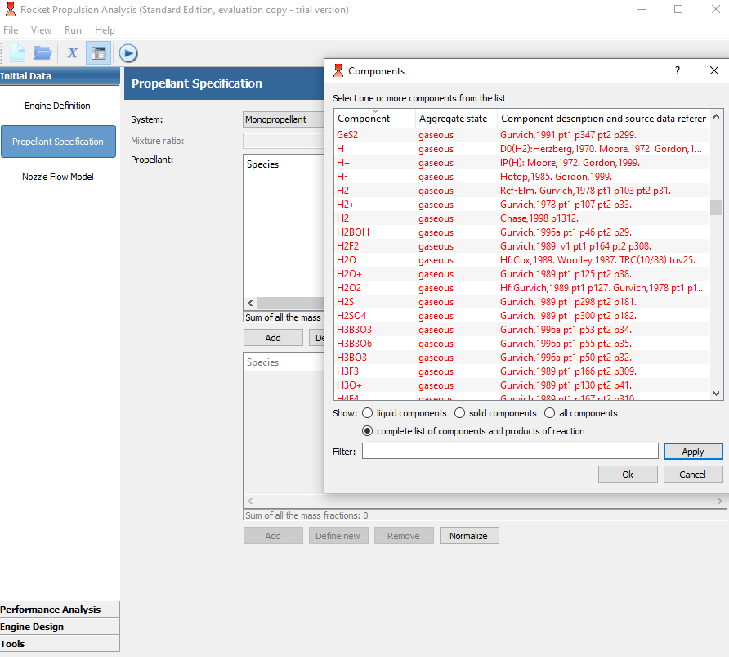
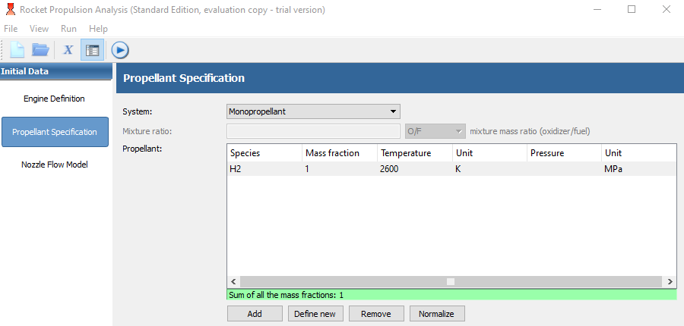
RPA

Slide 7
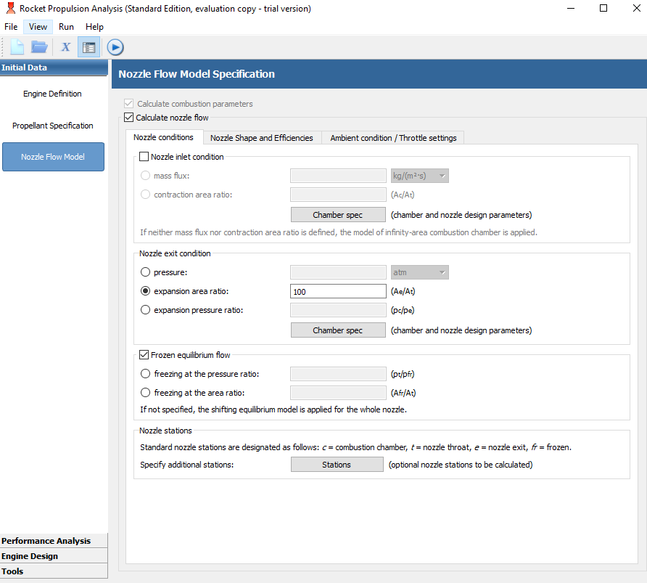
RPA
Must specify one of these
Not Checked = Frozen
Checked = Shifting Equilibrium
Specified freezing point = Sudden Freeze model (discussed later on how to find this)

Slide 8
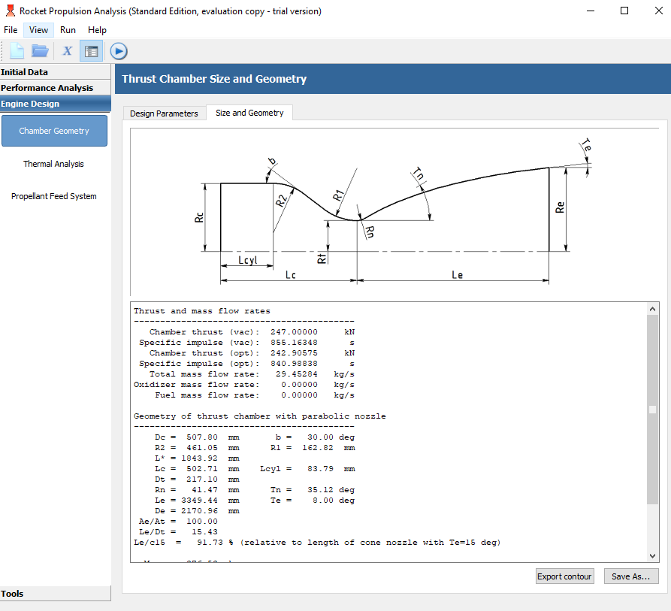
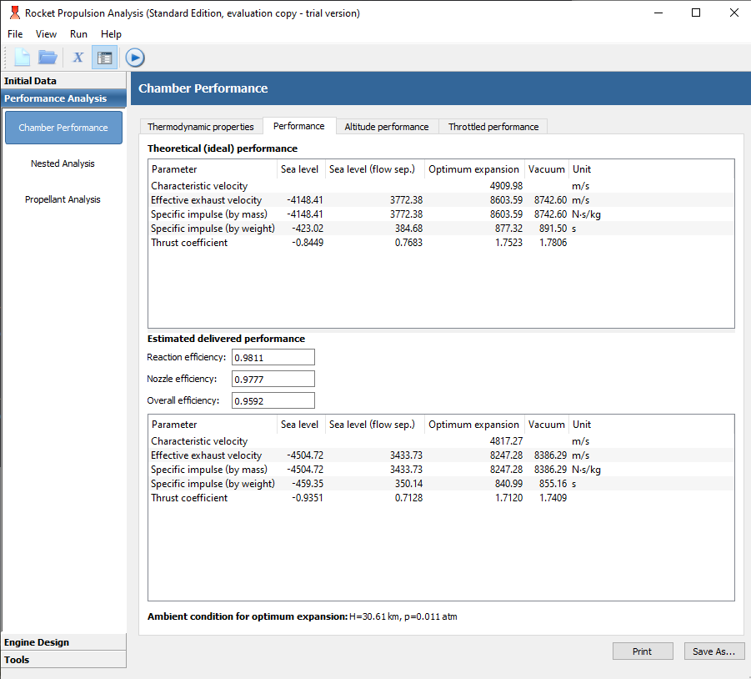
RPA (results)

Slide 9
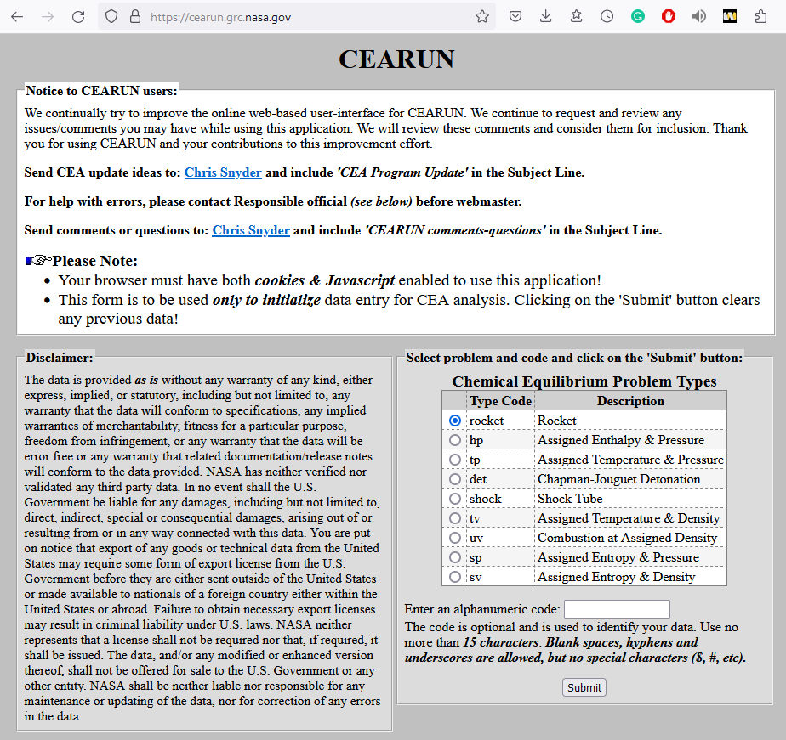
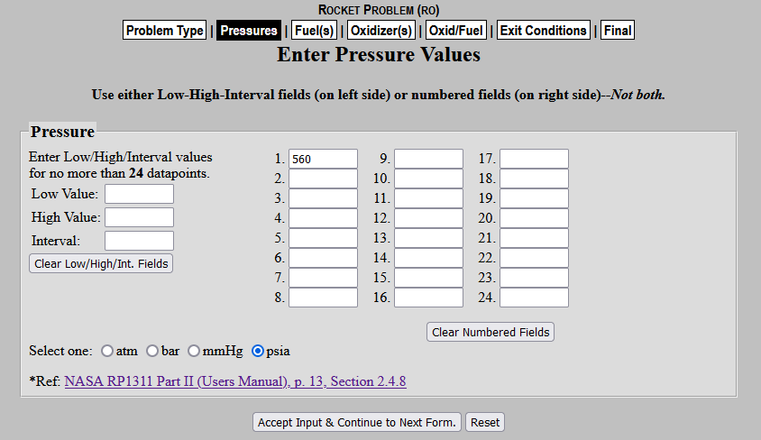
CEA
Alternatively, you can fill out multiple boxes if you wish to run a batch of different simulation conditions.

Slide 10
CEA
Alternatively, you can fill out multiple boxes if you wish to run a batch of different simulation conditions.

Slide 11
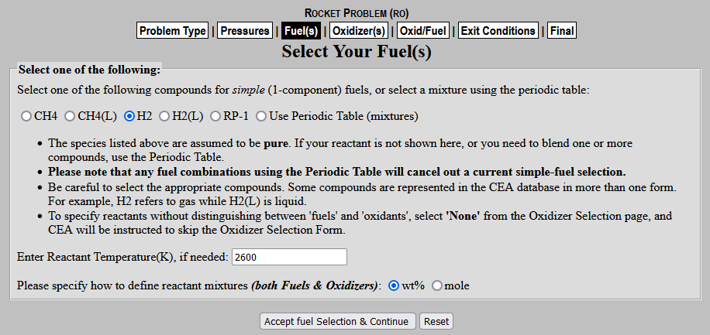
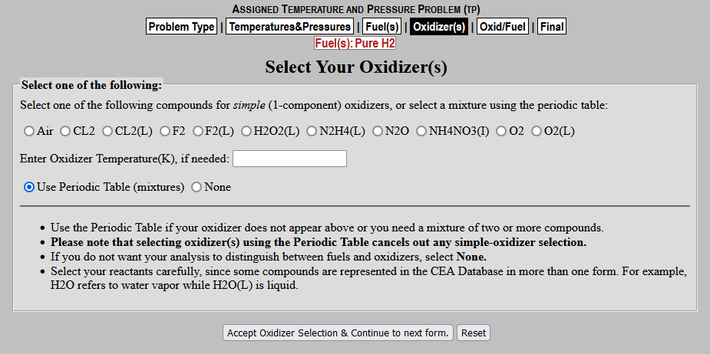
CEA (2)
If your propellant of choice is here you can just select it. If not select “Use Periodic Table (mixtures)” and proceed to next slide
Oxidizer does have a “None” option, but using it sometimes causes an error requiring you to use the periodic table to ensure the fuel and oxidizer are the same.

Slide 12
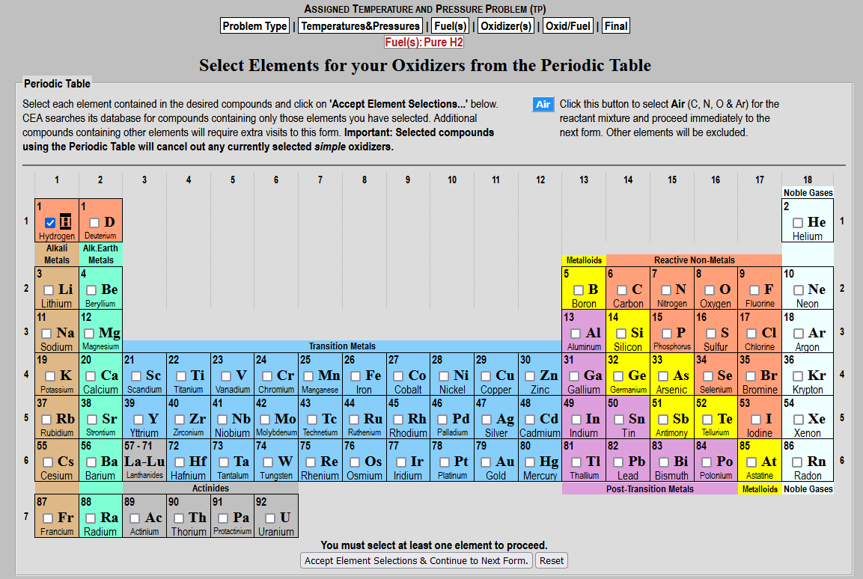
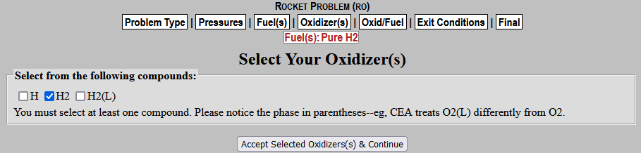
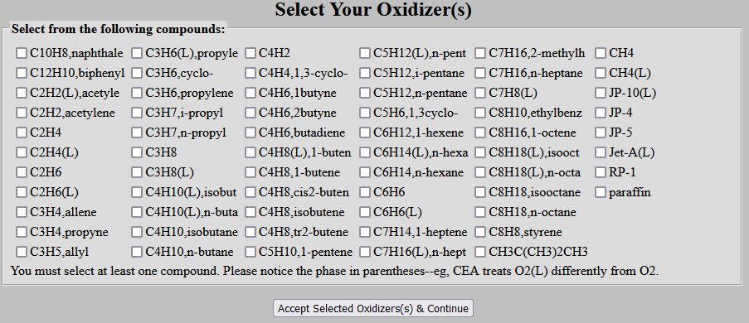
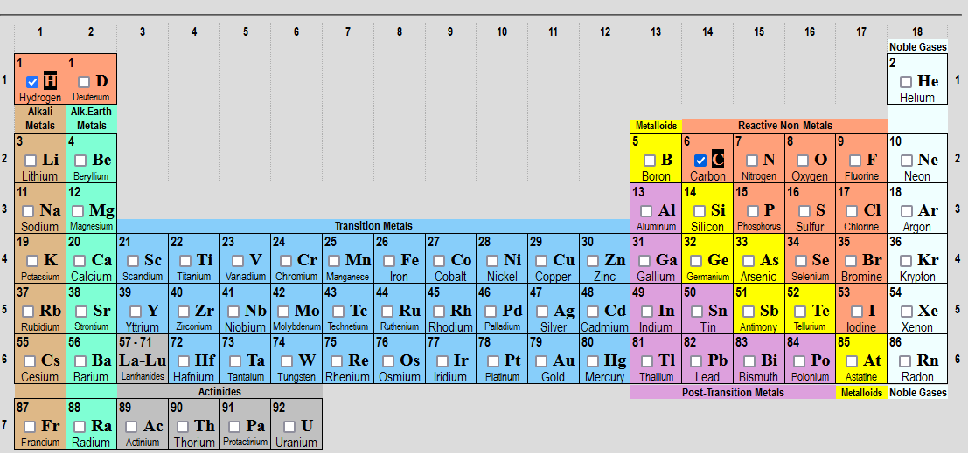
CEA (3)
Check the elements in the propellant of interest
Select the desired chemicals

Slide 13
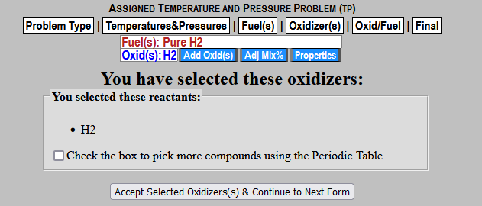
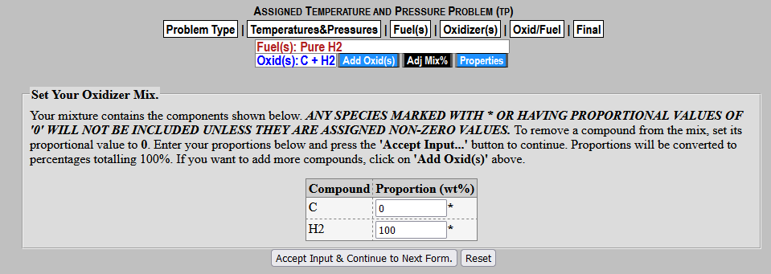
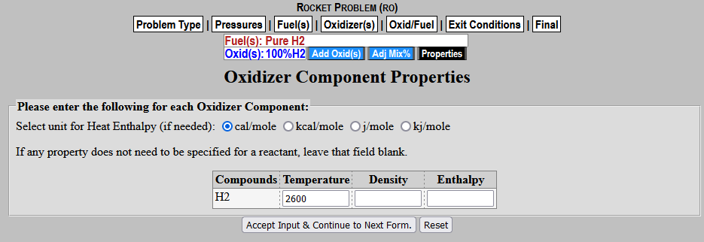
CEA (4)
Can be used if you want to add something else, such as radiation seed carbon or entrained uranium
If you set one of the compounds to 0, it will remove it from the list
Don’t worry about this screen

Slide 14
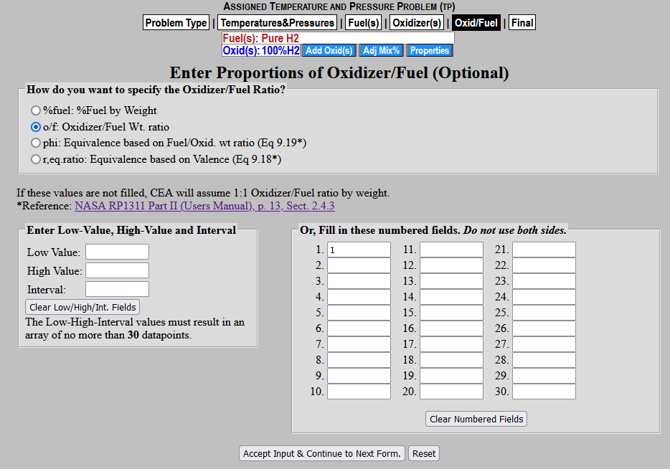
CEA (5)
If your Fuel and Oxidizer are the same, you can put any number here. Otherwise you will need to do the required math.

Slide 15
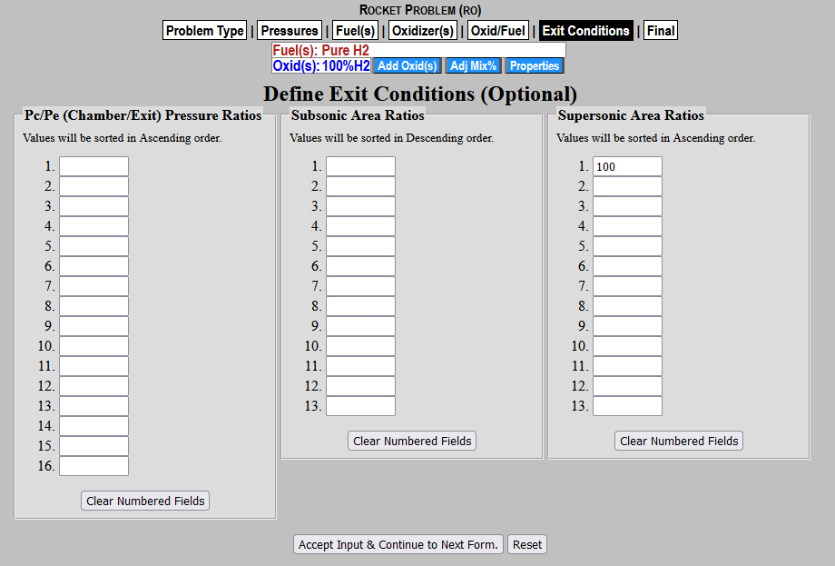
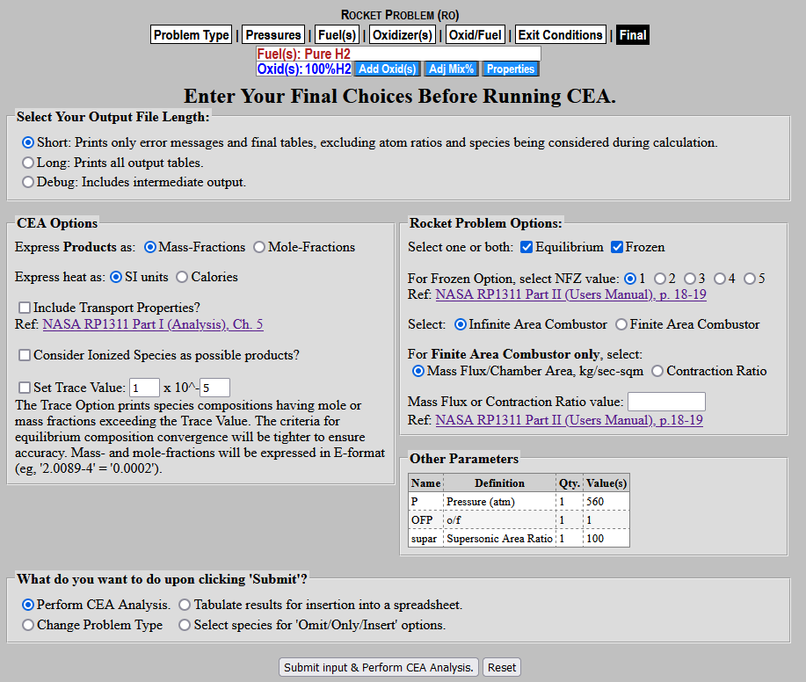
CEA (6)
Determines your nozzle size. CEA doesn’t do nozzle efficiency so there is no way to influence shape.
1 – freezes at chamber condition
2 – equilibrium up to throat than freezes
3-5 Seem to be inactive legacy code

Slide 16
CEA (7)
Determines your nozzle size. CEA doesn’t do nozzle efficiency so there is no way to influence shape.
1 – freezes at chamber condition
2 – equilibrium up to throat than freezes
3-5 Seem to be inactive legacy code

Slide 17
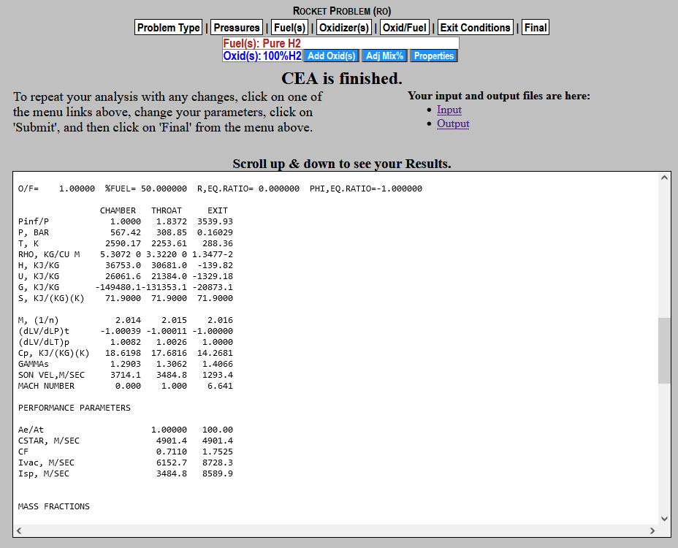
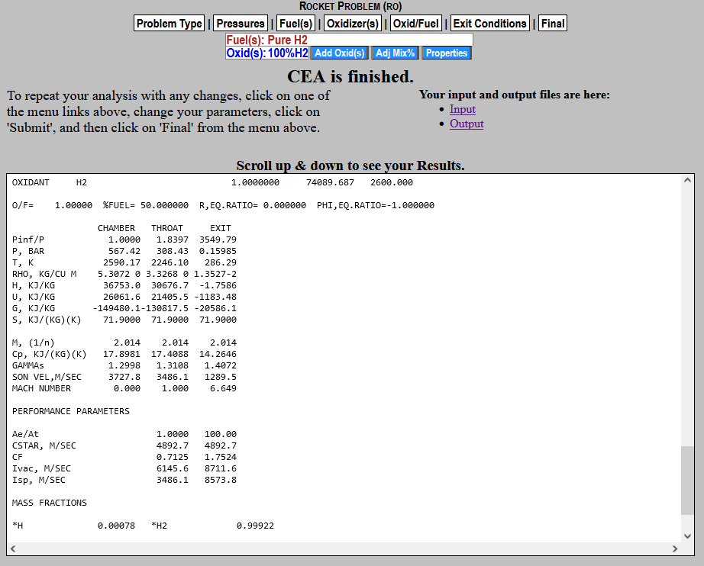
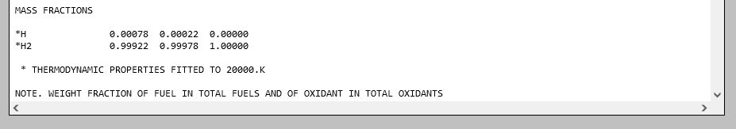
CEA (8)
Mass Specific Isp.
Divide by 9.81 m/s² to get weight specific Isp.
8728.3/9.81 = 890 s
If you select both equilibrium and frozen on the previous screen, the equilibrium is outputted first.

Slide 18
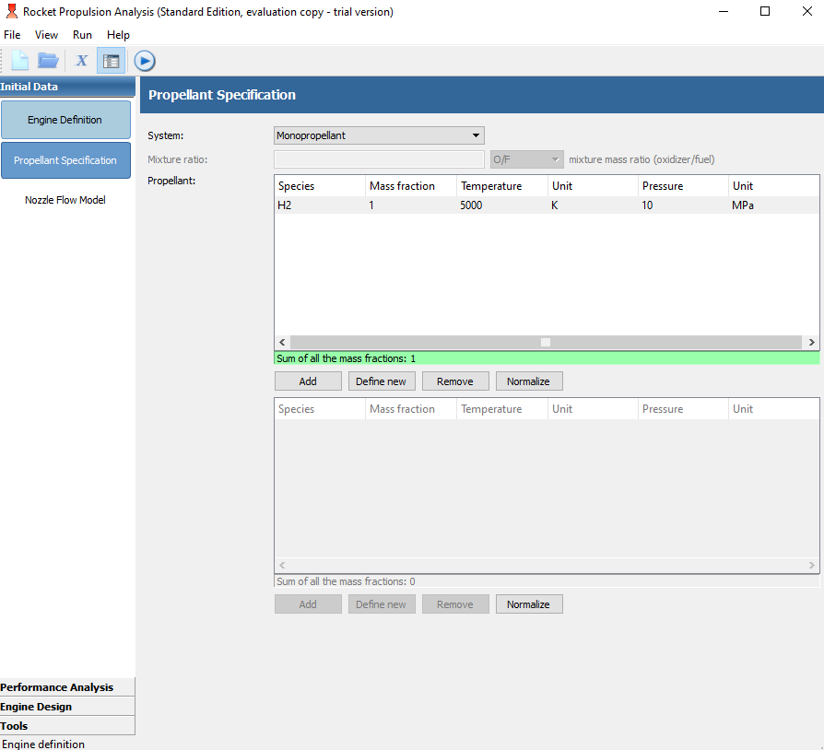
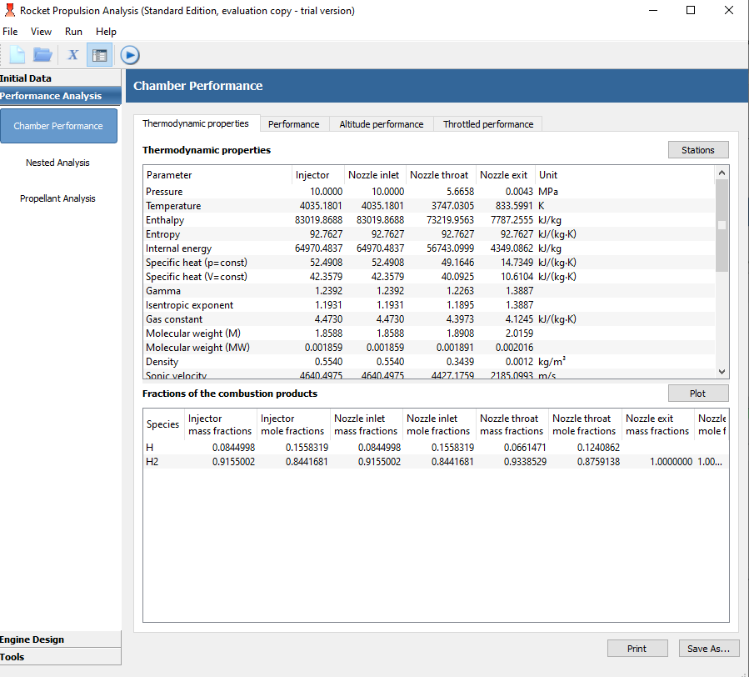
Word Of Caution
1000 K Drop in Temperature
RPA and CEA codes were intended for chemical combustion rockets and can cause problems for Nuclear/Solar/Electro-Thermal rockets if one does not pay attention.
If attempting to specify any propellant at a temperature and pressure where it would begin dissociating, both RPA and CEA will calculate the endothermic decomposition. This can significantly reduce the chamber temperature and your estimated performance.
ALWAYS CHECK THIS IF YOU ARE WORKING WITH A PROPELLANT IN A TEMPERATURE/PRESSURE COMBINATION YOU ARE NOT FAMILIAR WITH. LOW PRESSURES AND HIGH TEMPERATURE MAKE THIS WORSE.

Slide 19
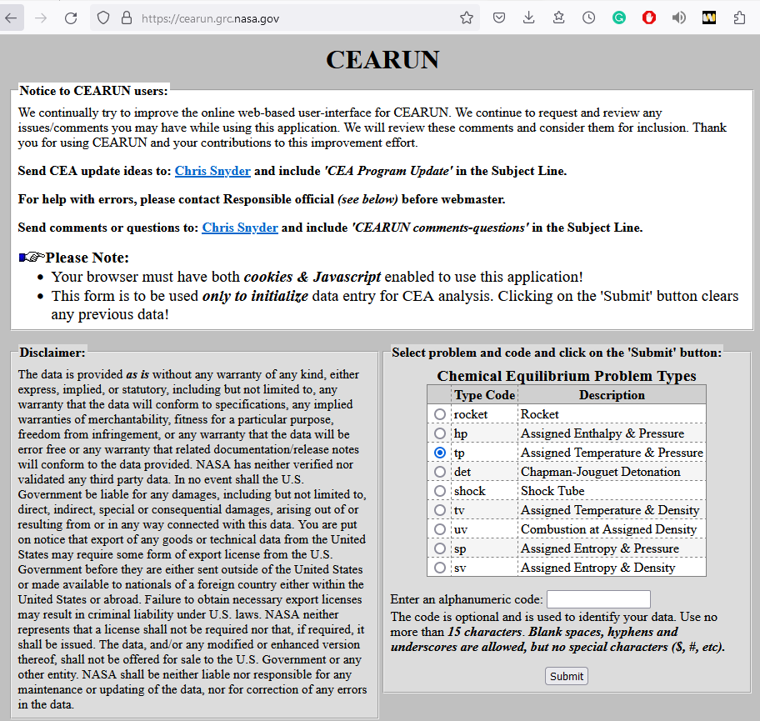
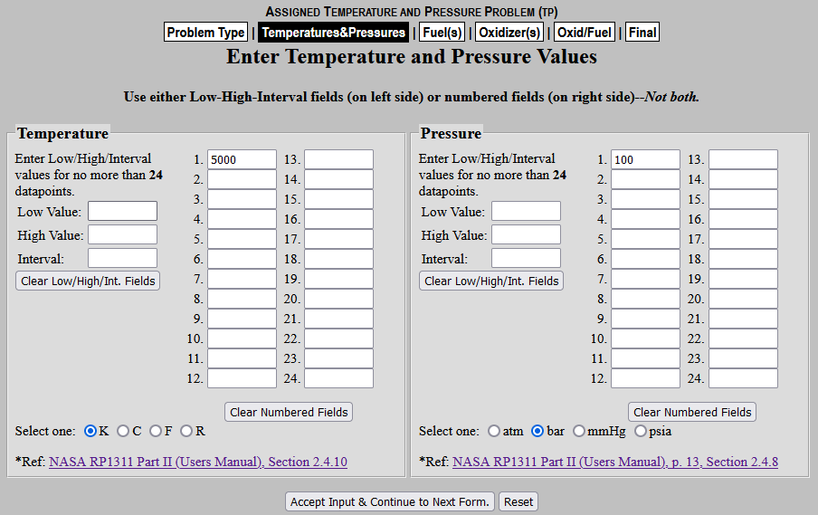
Avoiding Decomposition Discrepancy
Option 1: Trial and Error guessing required inlet temperature to get desired chamber temperature
Option 2: Using CEA (shown herein)
Fill in with your desired chamber conditions
Changes will not save unless you click this. Otherwise can navigate using the tabs up top

Slide 20
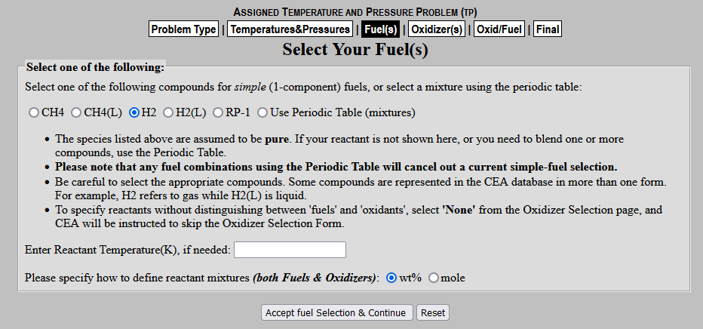
Avoiding Decomposition Discrepancy (2)
<- Can omit
If your propellant of choice is here you can just select it. If not select “Use Periodic Table (mixtures)” and proceed to next slide
Oxidizer does have a “None” option, but using it sometimes causes an error requiring you to use the periodic table to ensure the fuel and oxidizer are the same.
<- Can omit

Slide 21
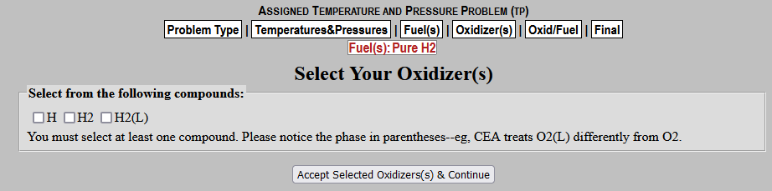
Avoiding Decomposition Discrepancy (3)
Check the elements in the propellant of interest
Select the chemical with the desired stichometry
-since temperature and pressure are specified, you need not be concern with selection liquid vs gaseous or H vs H2 or C3H4 allene vs C3H4 propyne. They will be converted to the appropriate state bye CEA upton calculation.

Slide 22
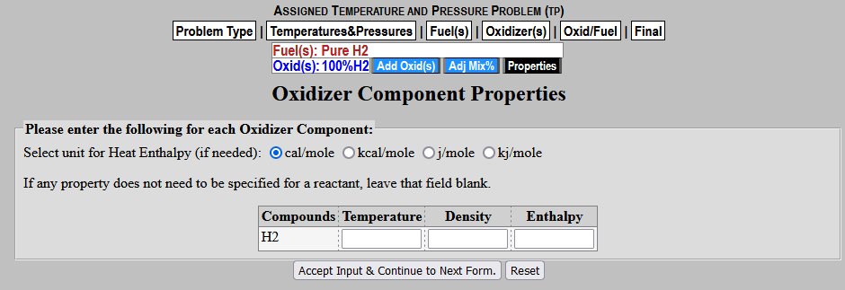
Avoiding Decomposition Discrepancy (4)
Can be used if you want to add something else, such as radiation seed carbon or entrained uranium
If you set one of the compounds to 0, it will remove it from the list
Don’t worry about this screen

Slide 23
Avoiding Decomposition Discrepancy (5)
If your Fuel and Oxidizer are the same, you can put any number here. Otherwise you will need to do the required math.

Slide 24
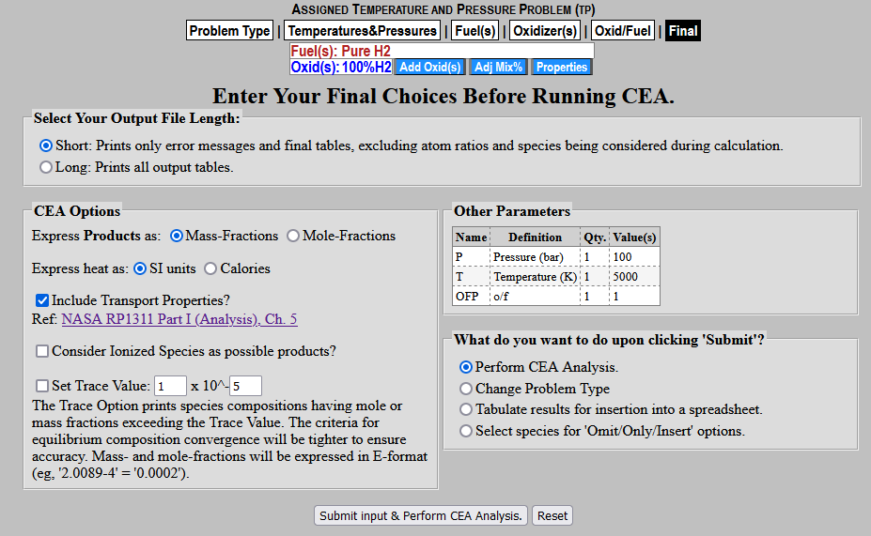
Avoiding Decomposition Discrepancy (6)
Defaults to Mass-Fraction which is what you need

Slide 25
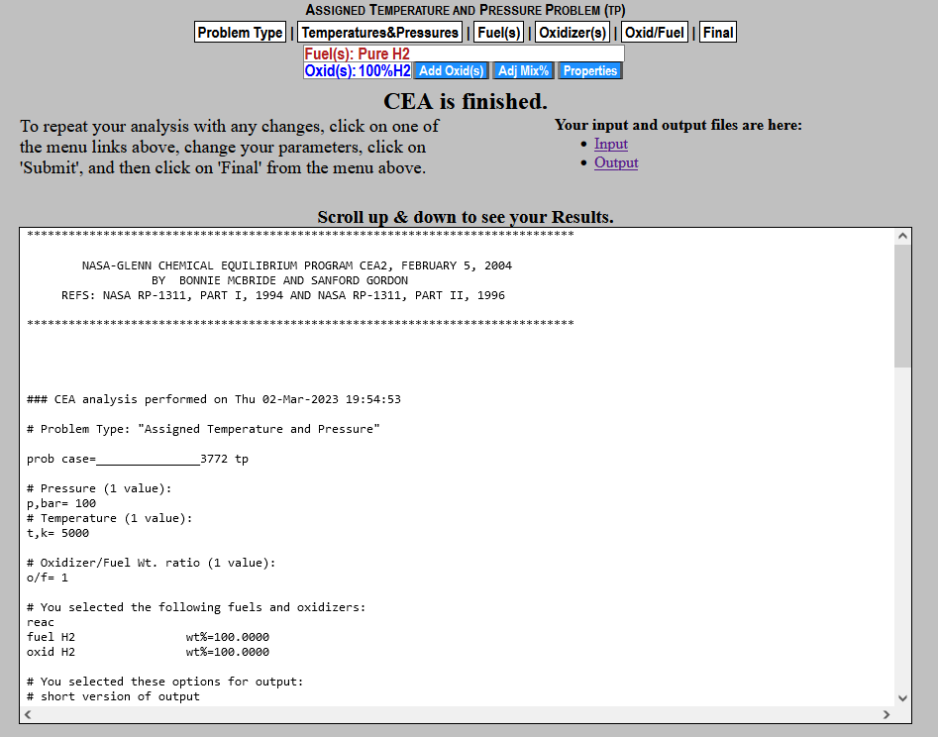
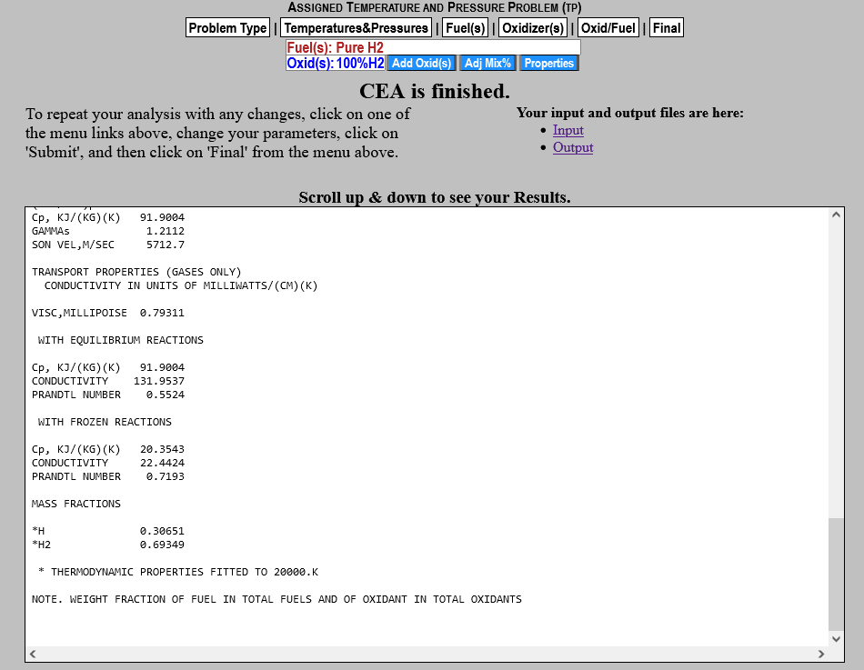
Avoiding Decomposition Discrepancy (7)
Scroll down
Write this down. This is what we came here for

Slide 26
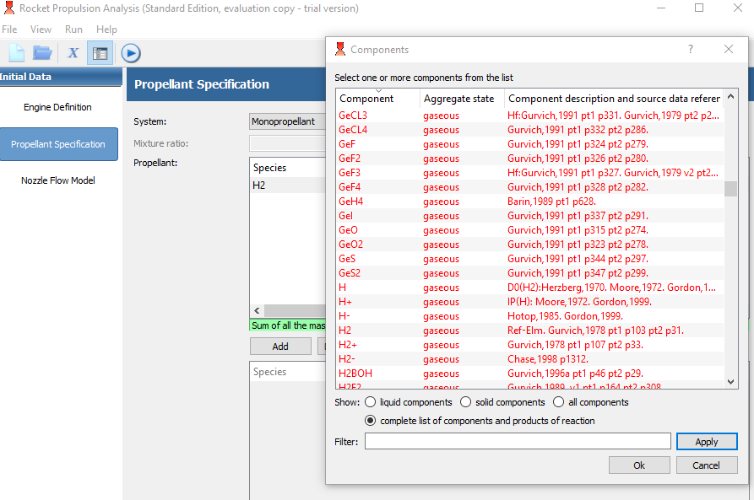
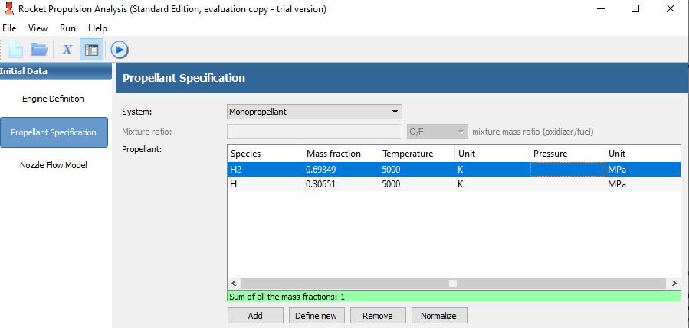
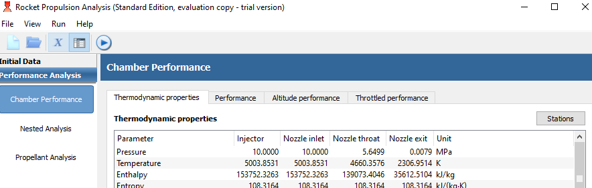
Avoiding Decomposition Discrepancy RPA
Specify all the dissociation species
Insert the Mass Fractions found in step 7
Notice RPA now predicts chamber temperature of 5003 K instead of 4035 K previously

Slide 27
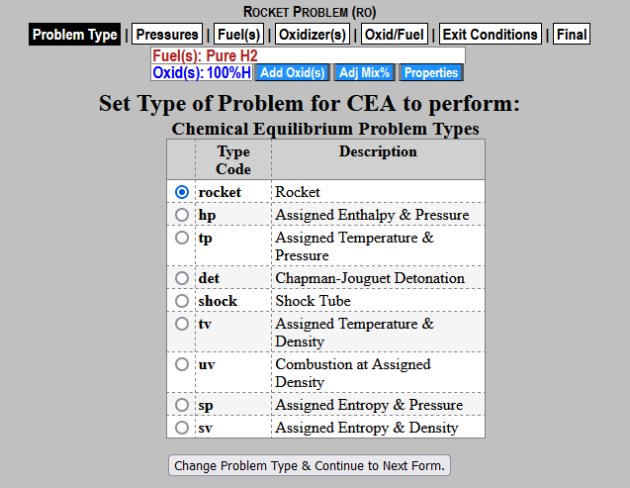
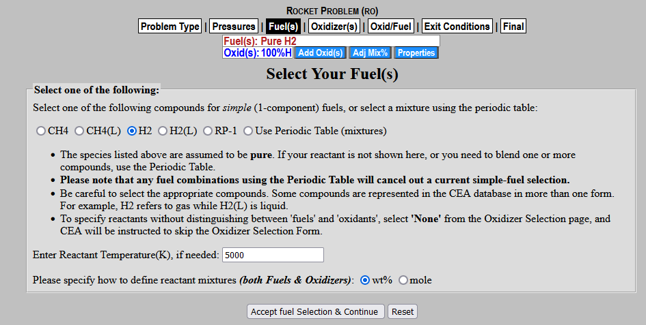
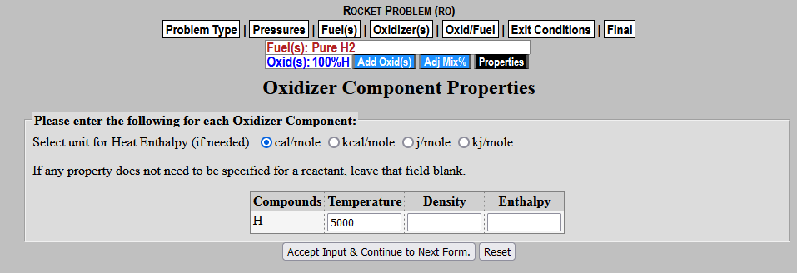
Avoiding Decomposition Discrepancy CEA (1)
Change to Rocket Calculator
<- Must Specify Now
<- Must Specify Now

Slide 28
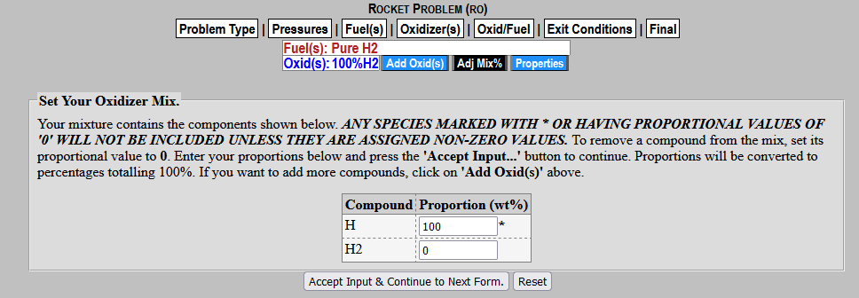
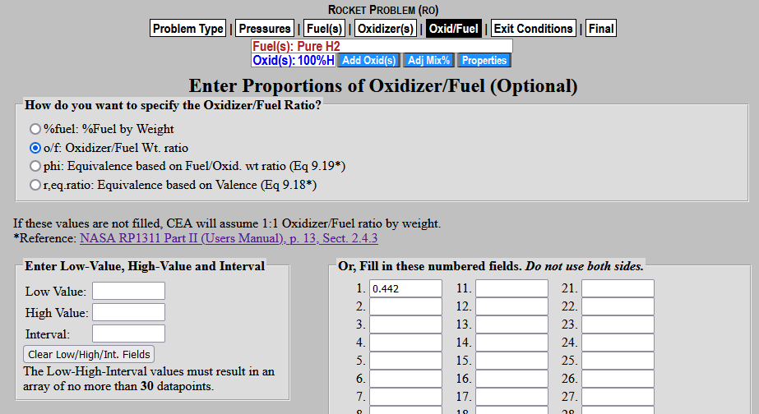
Avoiding Decomposition Discrepancy CEA (2)
If there are a lot of species, you will want to get to this screen through selecting “Use Periodic Table (mixtures)” and using the mass fractions found in step 7 times 100
Alternatively you may specify one species as fuel and other as ox and use the ratio of the mass fraction as the ox/fuel weight ratio

Slide 29
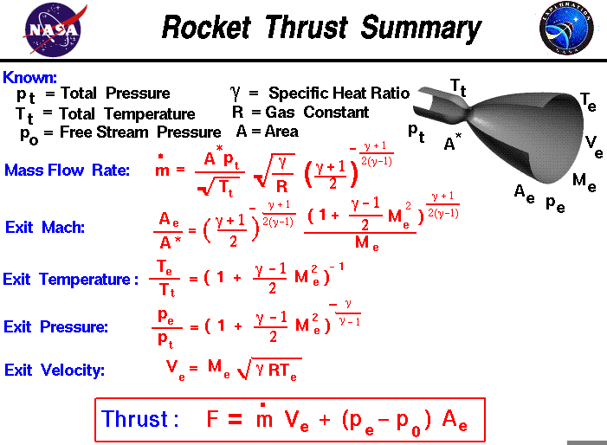
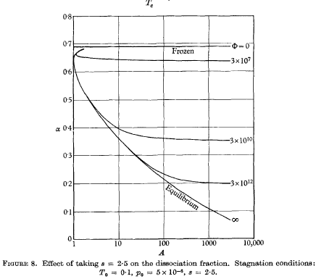
Frozen vs shifting equilibrium
Atomic Recombination in a hypersonic Wind-Tunnel Nozzle – K.N.C. Bray
Level of dissociation of a diatomic species
Area expansion Ratio
The commonly used equations for calculating the performance of a rocket assume the propellant is chemically frozen such that the chemical make up entering the nozzle and leaving the nozzle are identical
The temperature and pressure in a nozzle changes significantly and can sometimes change the chemical composition. Often such changes are exothermic and improve performance despite increasing exhaust molecular weight. Assuming chemical equilibrium at every point in the nozzle is often referred to as shifting equilibrium as the equilibrium state is constantly shifting throughout the nozzle.

Slide 30
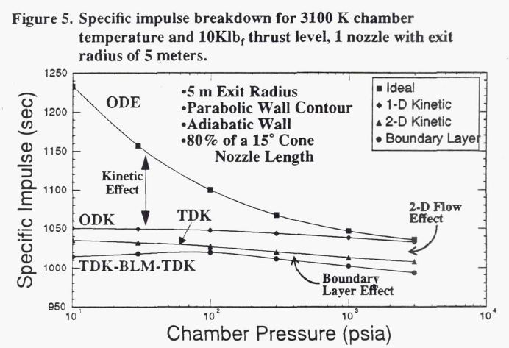
Real Nozzle
A real nozzle is significantly more complicated, but at low pressure and/or high temperatures Nozzle Kinetics become the single largest influencer in how the nozzle will behave.
Unfortunately, standard nozzle efficiency terms do not account for this and need to be handled separately.
Significant research was done on this in the 1990s for the Low Pressure Nuclear Thermal Propulsion (LPNTP) effort as it was the difference between 1300s and 1000s in some cases.
This was often done using NASA code called TDK (two-dimensional kinetics) or a 2D CFD analysis.
“Analytical Study of Nozzle Performance for Nuclear Thermal Rockets” – Davidian and Kacynski, 1991, NASA Tech Memo 105251

Slide 31
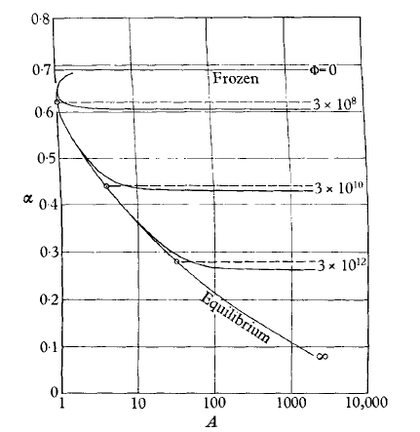
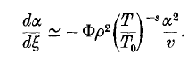
Sudden-Freeze (S-F) model
Atomic Recombination in a hypersonic Wind-Tunnel Nozzle – K.N.C. Bray
In 1959, Bray would develop a model for predicting the behavior of the high enthalpy flows of a pure diatomic species (O₂, N₂) in hypersonic wind tunnels.
The model stipulates that the true behavior of a nozzle can be approximated by assuming equilibrium up to a point and then frozen afterwards. He would develop this relationship:
Level of dissociation of a diatomic species
S-F approx
True Behavior
Dimensionless Dissociation Rate Parameter. Based off nozzle dimensions and chemical
S (constant related to dissociation behavior) some historic dispute. Bray recommends 0.
Change in level of dissociation (% monoatomic by mass) per non-dimensional nozzle length
Local dissociation
Area expansion Ratio
Local velocity
Local density
Local Temperature / Chamber Temperature

Slide 32

Sudden-Freeze (S-F) model
Atomic Recombination in a hypersonic Wind-Tunnel Nozzle – K.N.C. Bray
If we take a reference case (r) from which we can determine where this freezing point is, we are able to scale it to find the freezing point for a second set of operating conditions.
We want to find where the following is true
Level of dissociation of a diatomic species
$${\left(Фρ^{2}\frac{α^{2}}{v}\right)}_{r}=Фρ^{2}\frac{α^{2}}{v}$$
$$Ф= \frac{nozzle length (x_{l})}{\sqrt{nozzle exit area(A_{t})}}×dissociation terms$$
Since we are using a historical report with the same chemical species, the dissociation terms all cancel
$${\left(\frac{x_{l}}{\sqrt{A_{t}}}ρ^{2}\frac{α^{2}}{v}\right)}_{r}=\frac{x_{l}}{\sqrt{A_{t}}}ρ^{2}\frac{α^{2}}{v}$$
S-F approx
True Behavior
Area expansion Ratio
Often since I don’t have a firm idea of what the final size of our nozzle is going to be, I assume same nozzle size for both cases. The calculations are least sensitive to these terms in most cases, so the error is relatively small in this assumption.

Slide 33

Sudden-Freeze (S-F) model
Atomic Recombination in a hypersonic Wind-Tunnel Nozzle – K.N.C. Bray
To provide more insight into what this method physically means, we should consider that as the monoatomic species recombine into their diatomic form, you are recovering the energy originally used use to split the diatomic form (a chemical potential). This means that the rate of recombination $\frac{dα}{dξ}$ is proportional to the rate at which stored chemical potential is converted to thermal energy $\frac{dq}{dξ}$ capable of providing useful work.
Level of dissociation of a diatomic species
S-F approx
True Behavior
Area expansion Ratio

Slide 34
Sudden-Freeze (S-F) model
Atomic Recombination in a hypersonic Wind-Tunnel Nozzle – K.N.C. Bray
To provide more insight into what this method physically means, we should consider that as the monoatomic species recombine into their diatomic form, you are recovering the energy originally used use to split the diatomic form (a chemical potential). This means that the rate of recombination $\frac{dα}{dξ}$ is proportional to the rate at which stored chemical potential is converted to thermal energy $\frac{dq}{dξ}$ capable of providing useful work.
Level of dissociation of a diatomic species
S-F approx
True Behavior
Area expansion Ratio

Slide 35
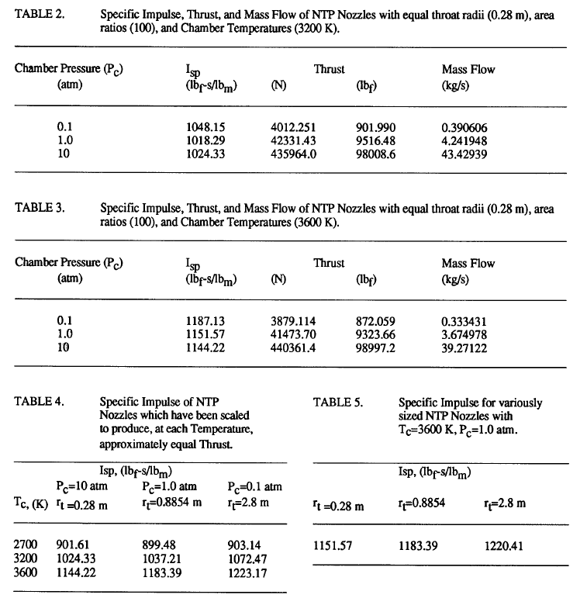
Sudden-Freeze (S-F) model
Step 1: Find a source in literature to use as the reference case
I tend to use “analysis of nuclear thermal propulsion systems using computation fluid dynamics” by Stubbs, Kim, and Papp.
The refence condition I typically us is highlighted as it is the closest to the to condition, I would expect in a liquid core nuclear rocket.
Remember this method is only approximate and there can be many ways to get your reference state (different reports, averaging multiple data points, etc.)

Slide 36
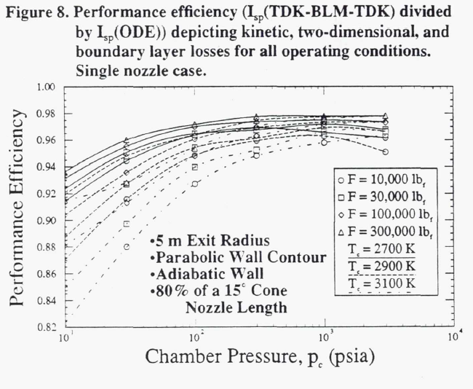
Sudden-Freeze (S-F) model
Step 2: We will want to extract the nozzle efficiency term from the Isp. We can only calculate the 1D kinetic effects using the S-F, so we need to account for not only the boundary layer losses, but the difference between a 1D and 2D kinetic model unless your reference case is a 1D kinetic model (this is usually on the order of 0.98-0.97). There are two options here:
Using a source from the literature particular to your problem. This is what I do using “Analytical Study of Nozzle Performance for Nuclear Thermal Rockets” – Davidian and Kacynski, 1991, NASA Tech Memo 105251.
Run the chamber conditions through RPA to calculate the “Nozzle efficiency” found under Performance Analysis -> Chamber Performance -> Performance
Averaging the figure we get ~0.97.
1144s / .97 = 1179s as the 1D kinetics performance

Slide 37
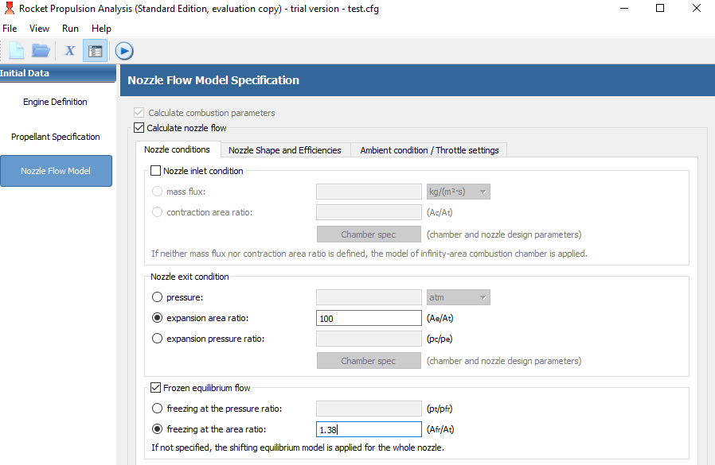
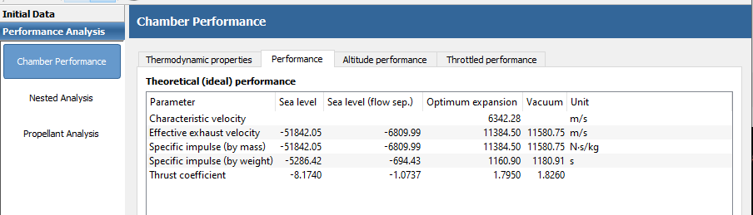
Sudden-Freeze (S-F) model
Step 3: Trial and Error time. This can only be done with CEA.
Go into RPA, fill in the chamber conditions, and now we are going to be using the Frozen Equilibrium Flow option.
Guess where the freezing plane is (using either the pressure ratio or the area ratio) and check on the IDEAL performance until we get to the proper value found last step.

Slide 38

Sudden-Freeze (S-F) model
Step 4: Getting the conditions at the freezing plane. You can do this in CEA or RPA.
For CEA, just run a rocket equation with an expansion ratio equal to where you found the freezing plane to be for equilibrium flow and take the properties from there.
For RPA we will add a “station” to output the desired properties at the freezing plane
Equal to the freezing plane

Slide 39


Sudden-Freeze (S-F) model
Step 5: Calculating the LHS of our equation
$$ρ^{2}\frac{α^{2}}{v}={0.0175}^{2}\frac{{0.0641706}^{2}}{6601.2317}≈2e−10$$
(you're going to be doing this calculation a few times shortly, would not be a bad idea to make a calculator in excel)
Remember to use the mass fraction

Slide 40


Sudden-Freeze (S-F) model Validity
Data is limited, but current data suggest good correlation with higher fidelity models.
The only computation model used to generate the S-F plot a single historical analysis of a NTR with chamber condition of 10 atm and 3600 K, yet continues to provide adequate results. I got a little conservative with nozzle efficiencies using 0.97 instead of 0.98-0.975 as would have been more proper for these cases.

Slide 41


Sudden-Freeze (S-F) model
Step 1: Trial and Error time. We need to find the point in the nozzle where our equation is satisfied. Unfortunately we can’t do this analytically since it required the knowledge of the local conditions in an equilibrium flow. As such we are forced to do simple iteration.
You can do this in RPA or CEA, using either the area ratio or the pressure ratio.
Input your desired chamber condition.
RPA -> Make a lot of stations and allow equilibrium flow through the entire nozzle
CEA -> Make a ton of different expansion ratio nozzles for equilibrium flow

Slide 42


Sudden-Freeze (S-F) model
Step 2: Calculate the recombination rate
Using the local conditions that are outputted. You are looking for an expansion ratio where
$${\left(ρ^{2}\frac{α^{2}}{v}\right)}_{r}=ρ^{2}\frac{α^{2}}{v}$$
This takes some trial and error and I recommend making a simple excel calculator. Some interpolation maybe required.
The right and left side can differ by ~15% without much error I have found. Things will be more sensitive the closer you get to the throat. I’ve found when the area ratio get to <1.1 you are already in a region where the difference between frozen and equilibrium is insignificant.

Slide 43



Sudden-Freeze (S-F) model
Step 3: use the found expansion ratio to calculate the 1D kinetics performance using the value found in step 2. RPA HAS TO BE USED FOR THIS STEP

Slide 44
Sudden-Freeze (S-F) model
Step 4: Apply the corrections required beyond the 1-D kinetic assessment. This is the inverse operation of step 2 from getting the reference case.
Use a solution from literature if you have one
Use the Nozzle efficiency calculated by RPA
You can ignore the reaction efficiency as it may cause issue when doing low pressure estimates
$$I_{sp}=1579 ×0.97=1532 s$$
You are done

